Slide 1

Alice Feng & Ya-chi Chu

Slide 2
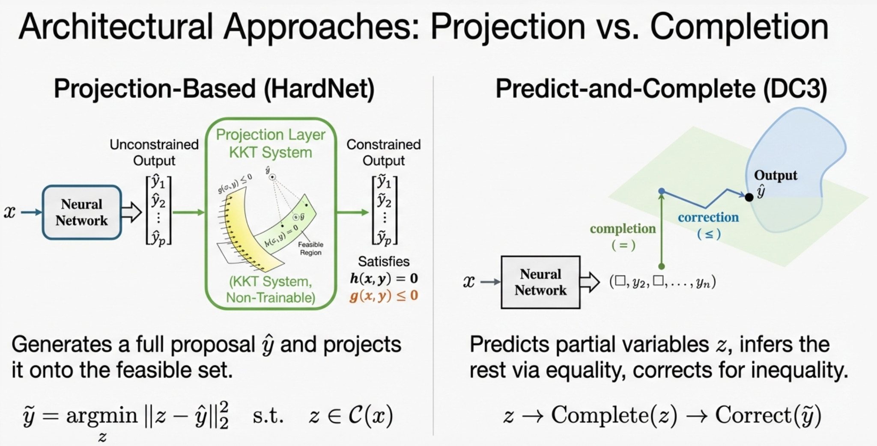
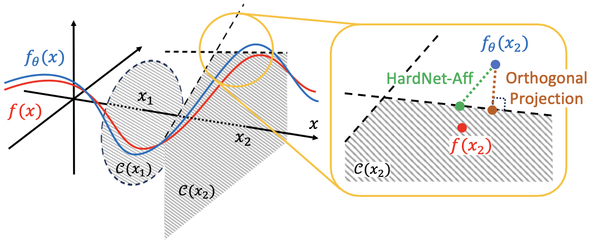

Slide 3
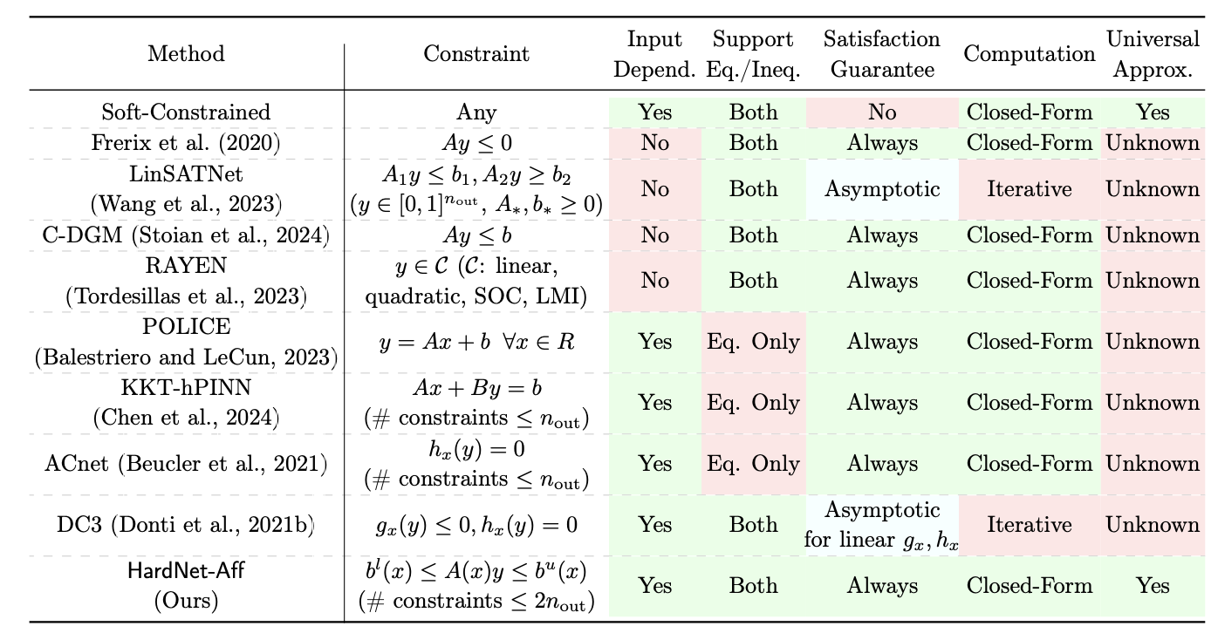
Overview of Constraint Enforcement in Neural Nets

Slide 4
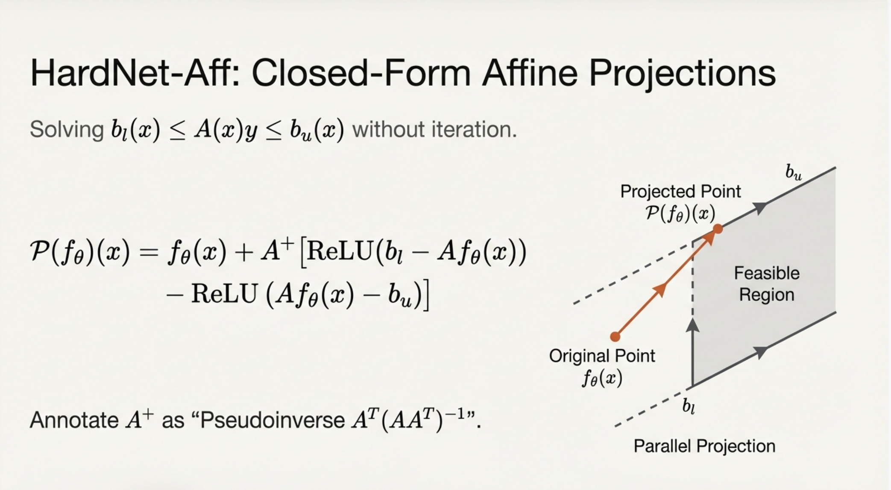

Slide 5
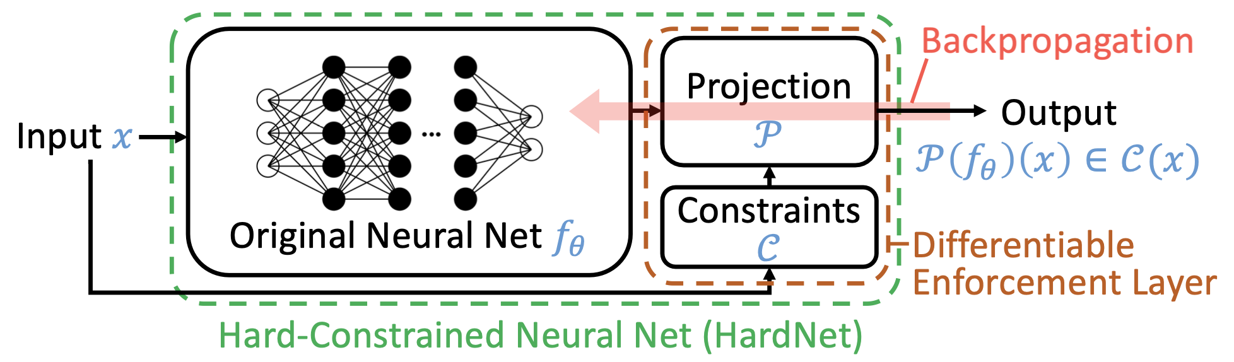
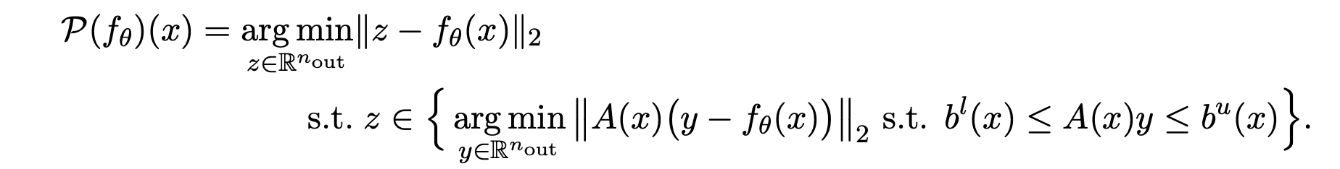
Architecture of HardNet
Projection Layer of HardNet-Aff solves

Slide 6
Discussion 1:
Projection Layer of HardNet-Aff solves
Does HardNet-Aff find the feasible point that is closest to the original neural net output f_{θ}(x)? Can you see the drawback of this formulation?

Slide 7
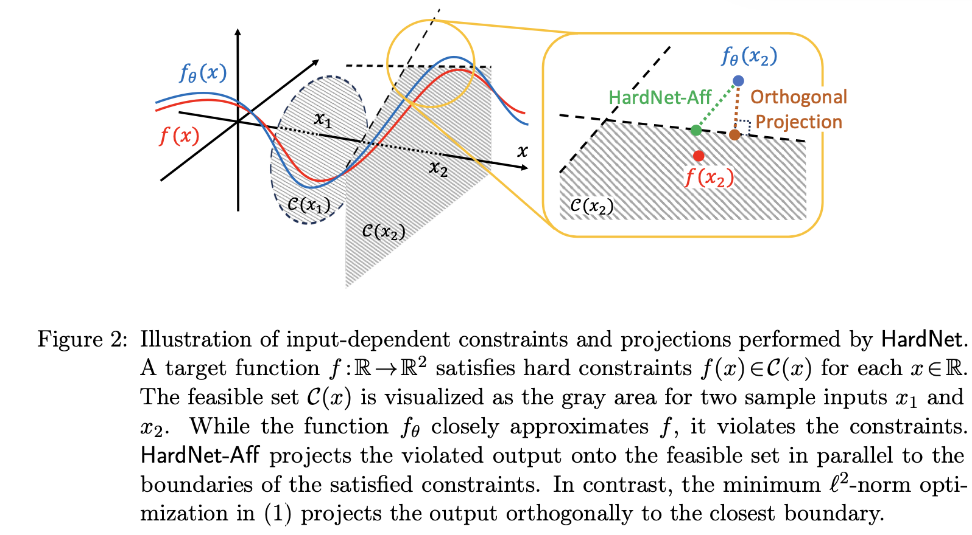

Slide 8
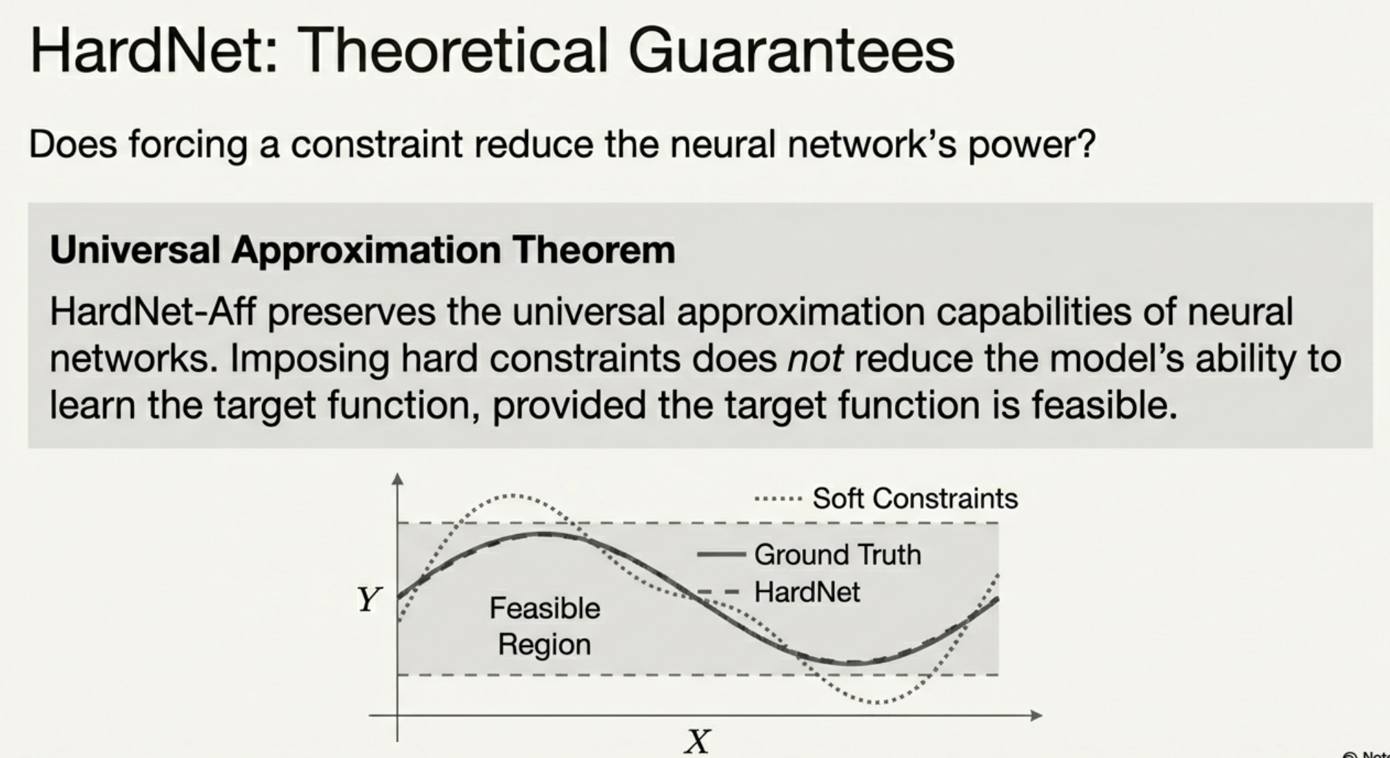

Slide 9
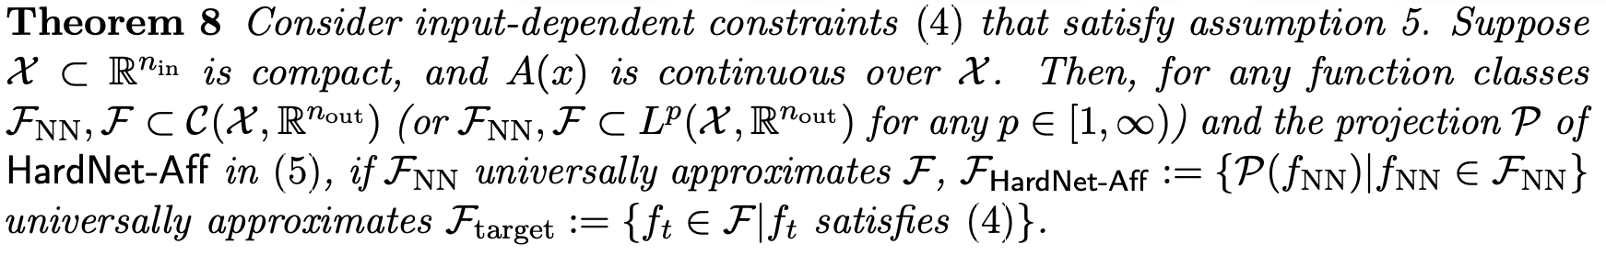
HardNet: Theoretical Guarantee
Translation: An optimally trained HardNet can universally approximate the solution of the constrained problem as long as the original neural net can universally approximate the unconstrained solution.
Discussion 2:
Does that guarantee that we can train a good HardNet using SGD or Adam?

Slide 10
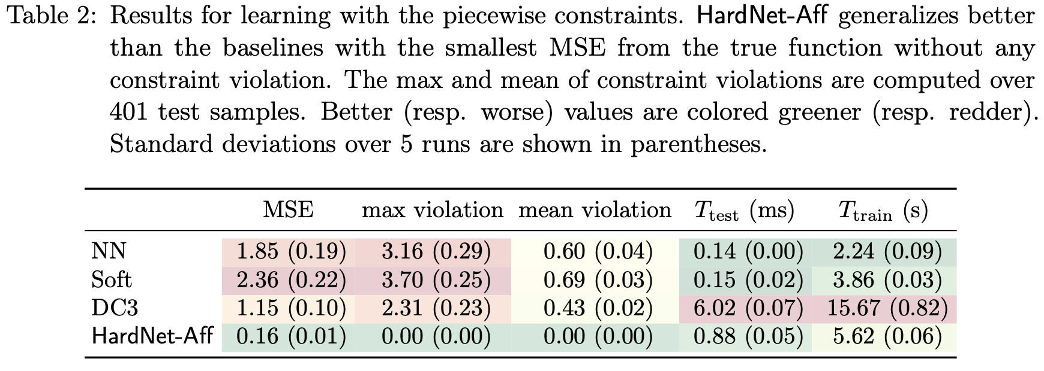
HardNet: Performance

Slide 11

Future Extension: HardNet-Cvx
For arbitrary constraints
Closely related to our next paper: KKT-HardNet

Slide 12
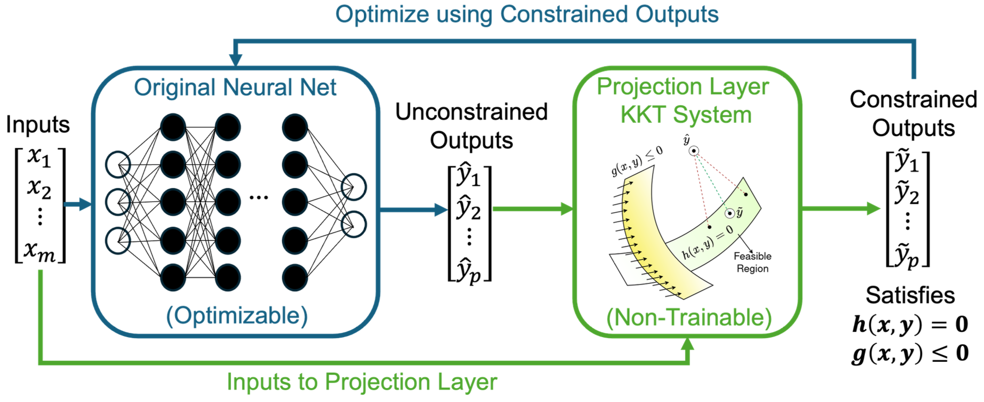
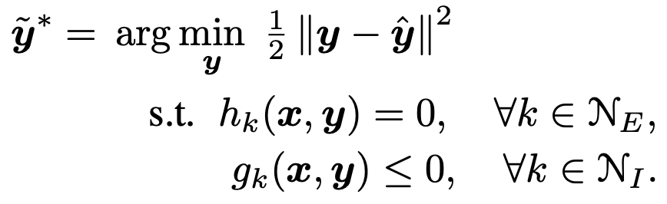
KKT-HardNet: Allowing General Constraints
The projection layer solves

Slide 13
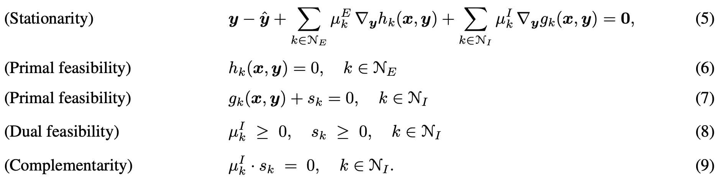
KKT-HardNet: Allowing General Constraints
The projection layer solves
The KKT system is solved with Newton-Type iterative root finder in forward pass
Discussion 3: How to compute the gradient through the KKT-projection layer?

Slide 14
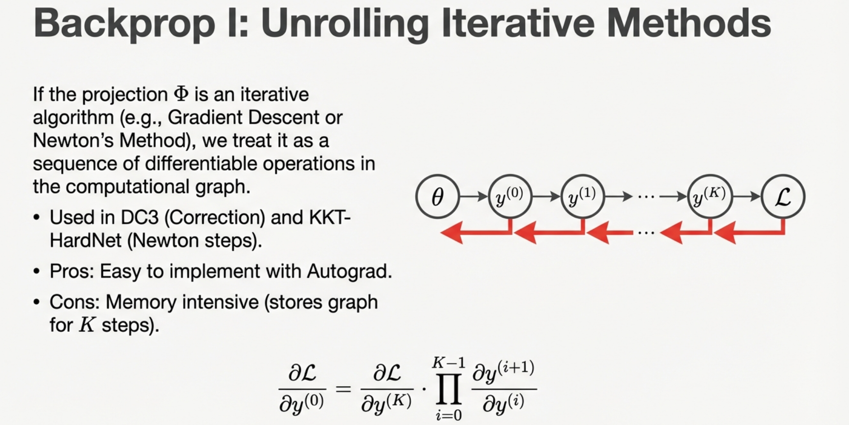
Used by FSNET and KKT-HardNet(which also uses Implicit Diff)

Slide 15

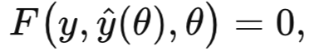
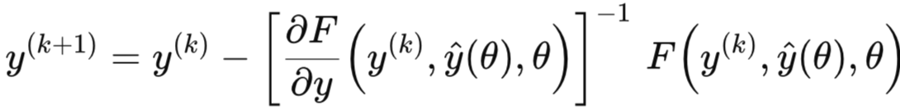
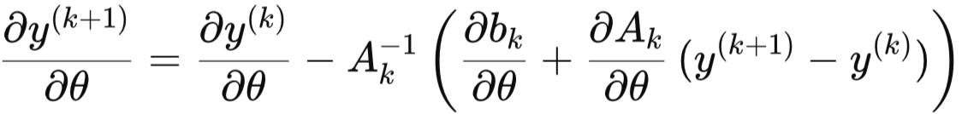

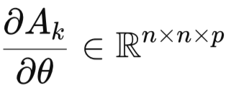

Example: Consider the following Newton root-finding iteration for
Where $ŷ$ is the output of unconstrained neural net, θ is the parameter to train
We can compute
where
is an extremely large array that you can hardly store

Slide 16
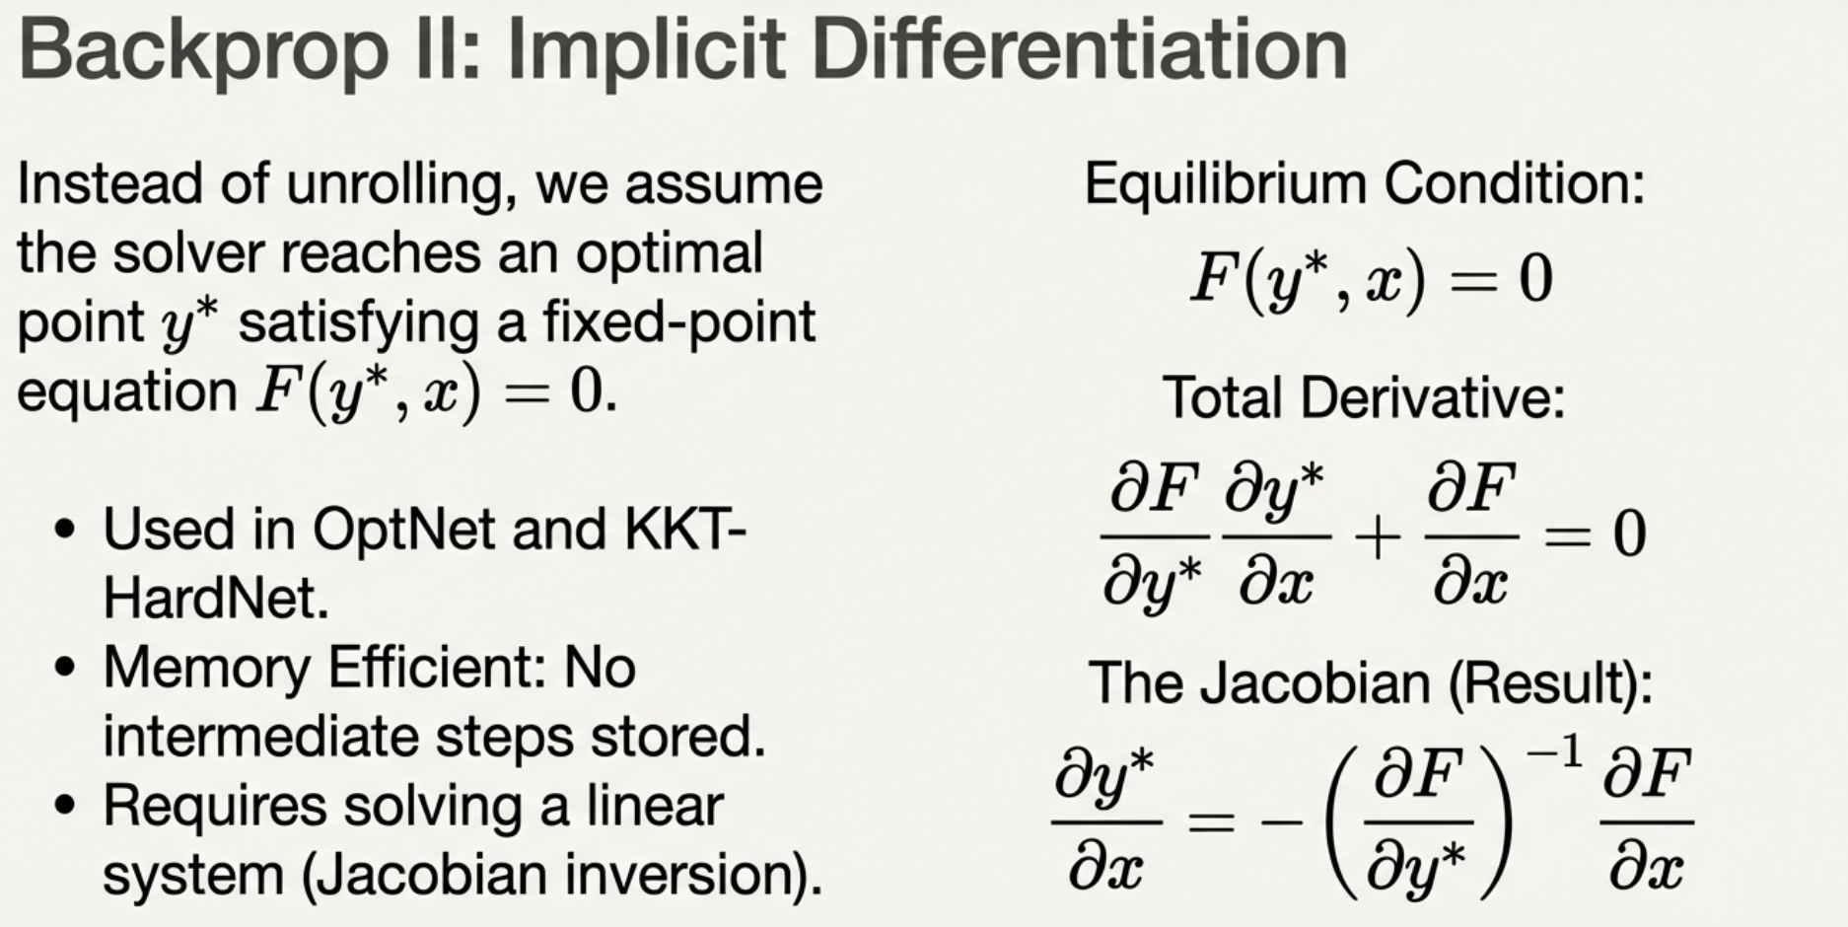

Slide 17
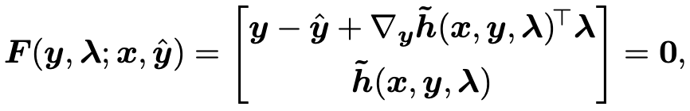

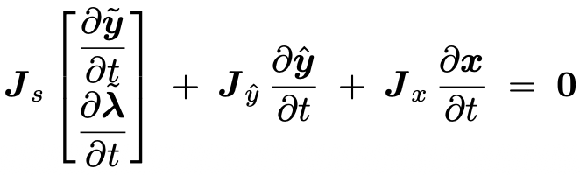
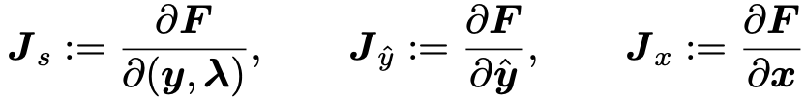
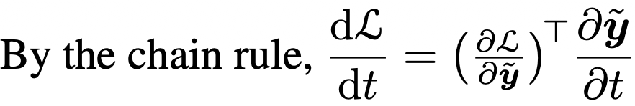
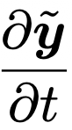

Computing Gradient Using Implicit Differentiation:
The KKT System after some change of variable:
Where $ŷ$ is the output of unconstrained neural net, $ỹ$ is the solution to the KKT-system
where
We want to compute
The KKT-HardNet paper proved that it is equivalent to solving a linear equation (as long as we can reuse the forward pass solutions)

Slide 18
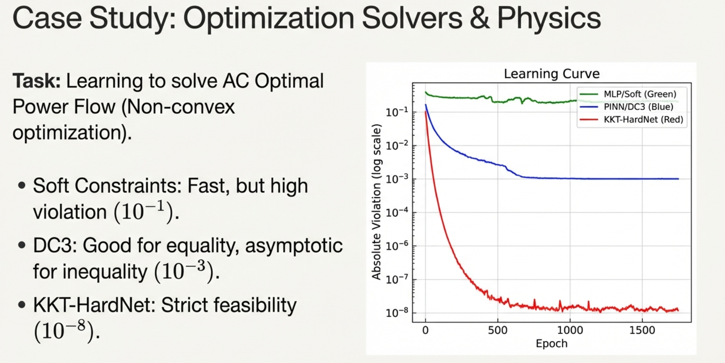

Slide 19
Discussion 4: Future directions

Slide 20
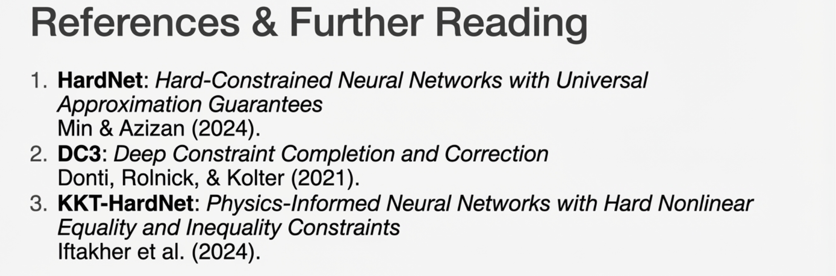

Slide 21
Quiz 2 (Open Question):
List an advantage or a disadvantage of HardNet compared to the penalty approach (that penalizes the the training loss for constraint violation).

